Slide 1

PROJECT SNAPSHOT
506
rows in the Boston Housing dataset
13
input features, with MEDV as target
Boston House Price Prediction
5
regression models compared
0.8752
R² of the best model, Random Forest
Machine Learning Engineer Internship
ShadowFox
Beginner Level Project
Prepared by: Samarth Jain
ShadowFox Program ID: SF-PID-2026-W7613

Slide 2


Project Overview
What is house price prediction?
Why machine learning?
Project objective
Estimating a home's value from its characteristics, such as size, rooms and neighbourhood.
Models learn patterns from historical data, including non-linear ones, and can be compared objectively on unseen data.
Predict MEDV from 13 input features using five regression models, then compare them with MAE, MSE and R².

Slide 3

Dataset Overview
506
14
Boston Housing dataset
rows
columns
What the target represents
MEDV is the median value of owner-occupied homes, in thousands of dollars. It is the value the models learn to predict.
Two key features
RM: average number of rooms per dwelling
LSTAT: percentage of lower-status population
13
1
input features
target: MEDV

Slide 4
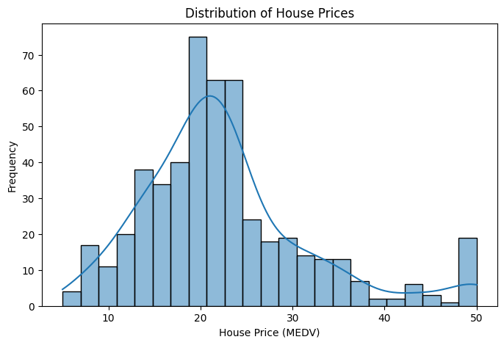
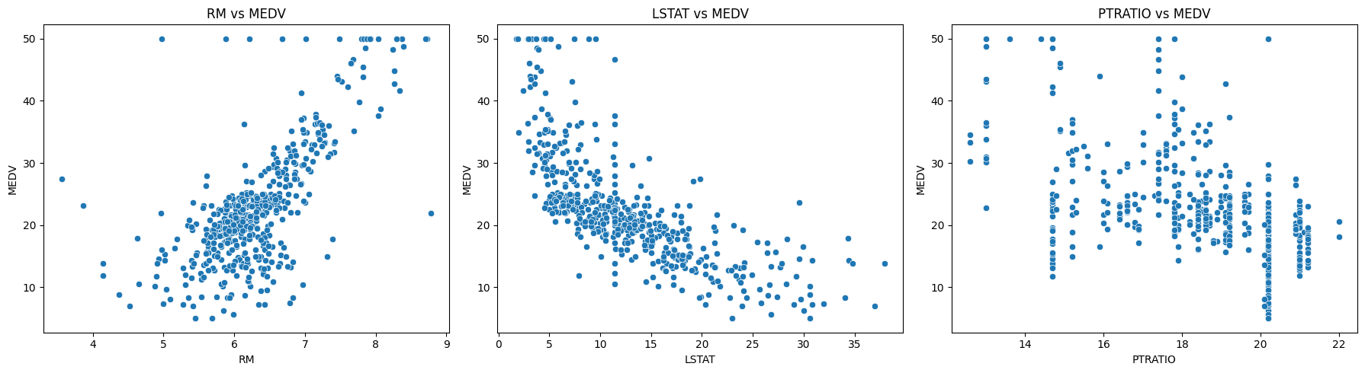
Exploratory Data Analysis
MEDV: what the notebook shows
Mean 22.53 and median 21.2, ranging from 5.0 to 50.0
Most homes sit around 20, with a long tail towards higher prices
16 homes sit at the maximum of 50.0, visible as a spike on the right
IQR check flagged 40 MEDV values as outliers
Correlation with MEDV
RM
+0.70
LSTAT
-0.72
PTRATIO
-0.51

Slide 5
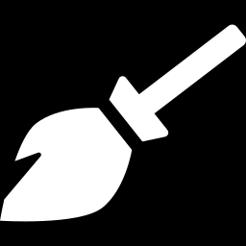
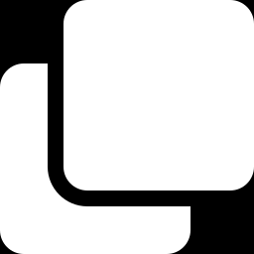

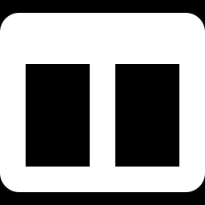
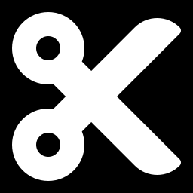
Data Preprocessing
Missing values
20 gaps in each of 6 columns, filled with median (CHAS: mode)
Train-test split
Duplicate check
80%
20%
0 duplicate rows found
Outlier investigation
Training: 404 rows
Test: 102
IQR check on MEDV flagged 40 values; all rows kept
Features and target
X: 13 input features
y: MEDV (target)
Dataset: 506 rows in total
13 features (X) separated from MEDV (y)
Train-test split
80% train, 20% test, random_state 42

Slide 6
Machine Learning Workflow
1
2
3
4
5
6
7
8
Dataset
Data Cleaning
EDA
Feature Selection
Train-Test Split
Model Training
Evaluation
Model Comparison
The same split and the same metrics are used for all five models, so the comparison is fair.

Slide 7
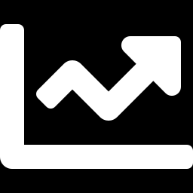
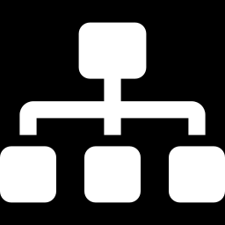

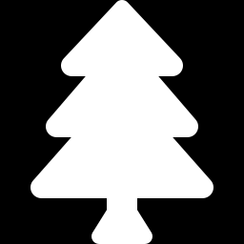
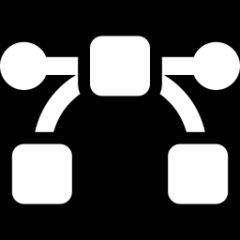
Models Implemented
1. Linear Regression
2. Decision Tree Regressor
3. Gradient Boosting Regressor
4. Random Forest Regressor
5. Support Vector Regression (SVR)
Fits a straight-line relationship between features and price. Simple and easy to interpret.
Splits the data with if-else rules arranged as a tree. Captures non-linear patterns.
Builds trees one after another, each correcting the errors of the previous ones.
Averages many decision trees trained on random subsets of the data to reduce overfitting.
Fits a function within an error margin, using kernels to model non-linear patterns.
Settings: Default settings
Settings: max_depth = 4
Settings: 100 trees, learning rate 0.05, max_depth = 2
Settings: 100 trees, max_depth = 5
Settings: RBF kernel, C = 10, scaled features

Slide 8
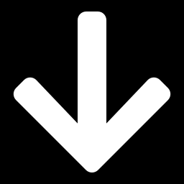

Model Evaluation Metrics
MAE
MSE
R²
Mean Absolute Error
Mean Squared Error
R² Score
Average size of the prediction errors, in the same units as MEDV.
Average of the squared errors. Penalises large errors more heavily.
Share of the variance in MEDV that the model explains. It is not prediction accuracy.
Lower is better
Lower is better
Higher is better

Slide 9
Model Comparison
Model | MAE | MSE | R² Score
Linear Regression | 3.1487 | 24.9994 | 0.6591
Decision Tree | 2.7776 | 12.4201 | 0.8306
Gradient Boosting | 2.3624 | 12.4420 | 0.8303
Random Forest | 2.2140 | 9.1504 | 0.8752
SVR | 2.0810 | 13.9944 | 0.8092
Best value in each metric column
Random Forest
lowest MSE, highest R²
SVR
lowest MAE
Linear Regression
weakest on all three metrics
Lower is better for MAE and MSE; higher is better for R².

Slide 10
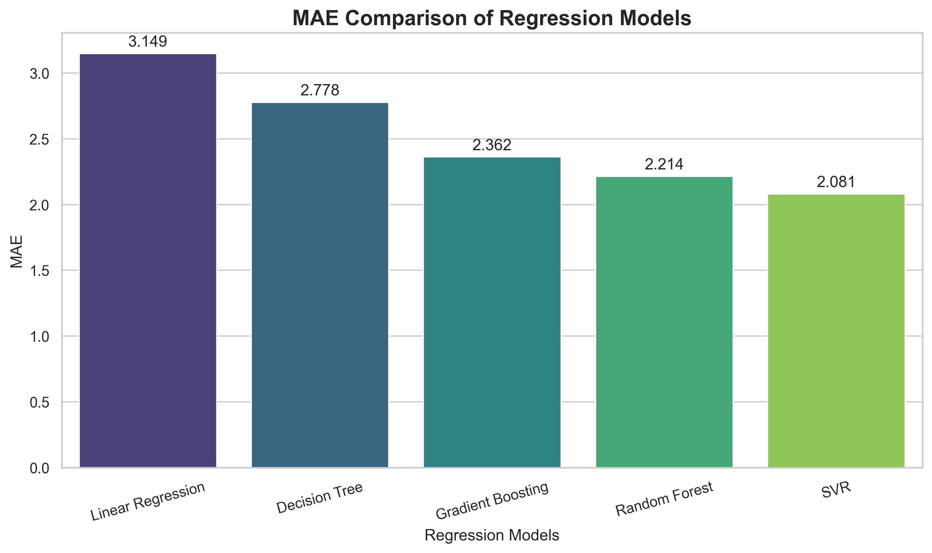
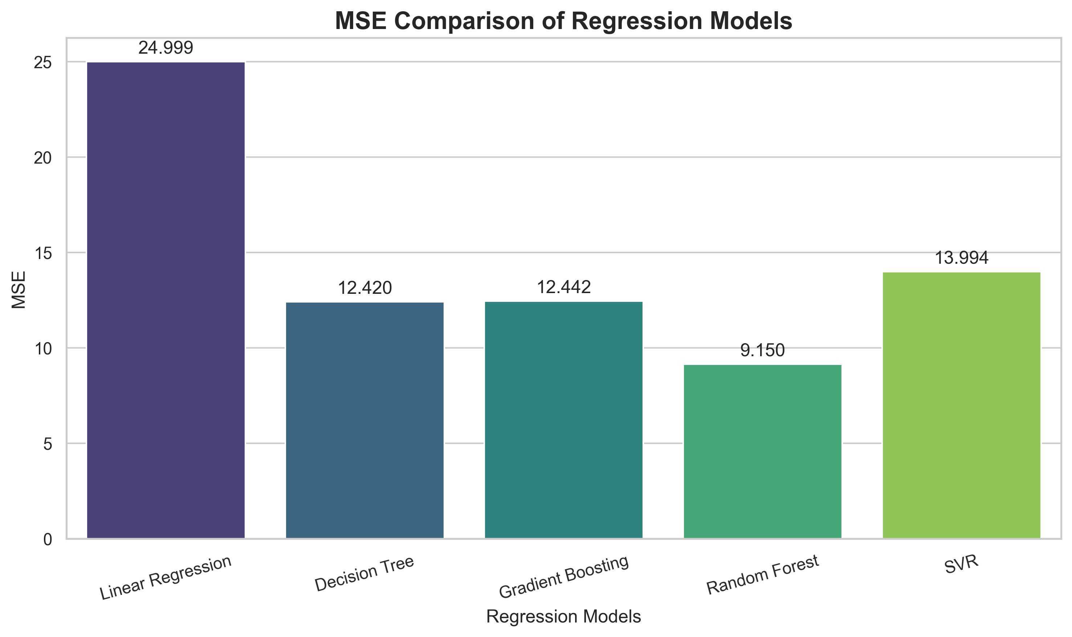
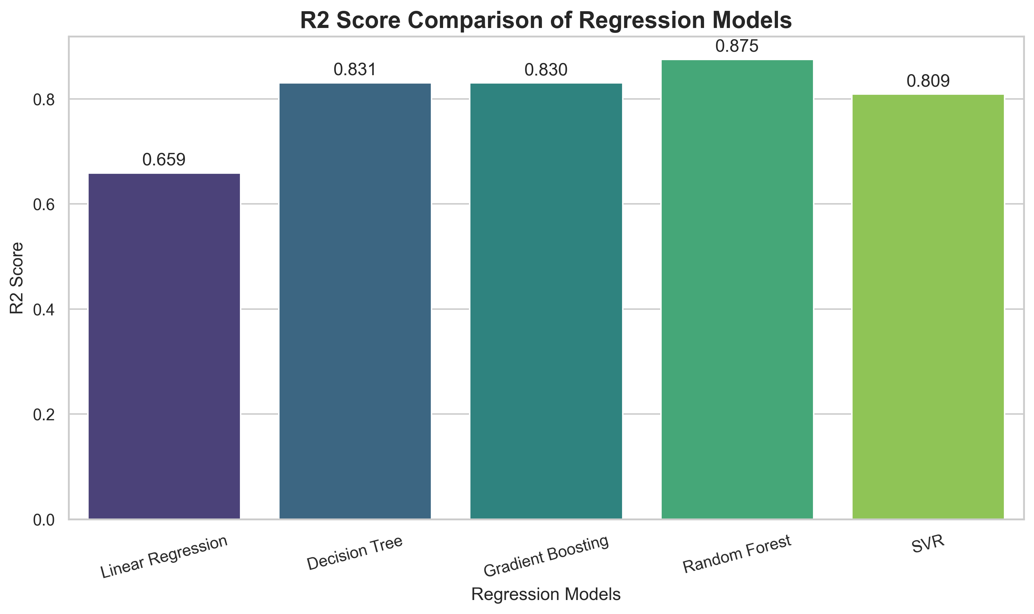
Performance Visualizations
Lower is better
SVR is lowest at 2.0810
Random Forest follows at 2.2140
Lower is better
Random Forest is lowest at 9.1504
Linear Regression is highest at 24.9994
Higher is better
Random Forest is highest at 0.8752
Linear Regression is lowest at 0.6591

Slide 11
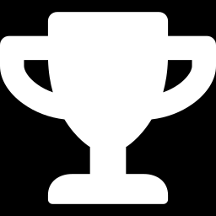
Best Performing Model
2.2140
9.1504
0.8752
Random Forest Regressor
MAE
MSE
R² Score
Best overall model
Lowest MSE: 9.1504, so large errors were smallest
Highest R²: 0.8752 of MEDV variance explained
SVR achieved the lowest MAE (2.0810), with Random Forest next at 2.2140
Lowest MSE and highest R² among the five models.

Slide 12

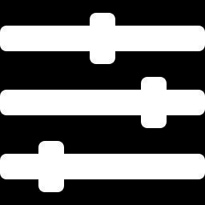
Conclusion and Future Improvements
What we learned
Selected model
Future improvements
Five regression models were compared on the same 80/20 split
All four non-linear models clearly beat Linear Regression on R²
Metric choice matters: SVR led on MAE, Random Forest on MSE and R²
Random Forest Regressor
MAE 2.2140
MSE 9.1504
R² 0.8752
Hyperparameter tuning
Cross-validation
More robust preprocessing, e.g. pipelines fitted on training data only
Thank You

